Slide 1
DATA MINING LECTURE 8
Clustering Validation

Slide 2
CLUSTERING VALIDITY

Slide 3
Cluster Validity
How do we evaluate the “goodness” of the resulting clusters?
But “clustering lies in the eye of the beholder”!
Then why do we want to evaluate them?
To avoid finding patterns in noise
To compare clustering algorithms

Slide 4
Clusters found in Random Data
Random Points
DBSCAN
K-means
Complete Link

Slide 5
Different Aspects of Cluster Validation
Determining the clustering tendency of a set of data, i.e., distinguishing whether non-random structure actually exists in the data.
Comparing the results of a cluster analysis to externally known results, e.g., to externally given class labels.
Evaluating how well the results of a cluster analysis fit the data without reference t`o external information.
- Use only the data
Comparing the results of two different sets of cluster analyses to determine which is better.
Determining the ‘correct’ number of clusters.

Slide 6
Measures of Cluster Validity
Numerical measures that are applied to judge various aspects of cluster validity, are classified into the following three types.
External Index: Used to measure the extent to which cluster labels match externally supplied class labels.
E.g., entropy, precision, recall
Internal Index: Used to measure the goodness of a clustering structure without reference to external information.
E.g., Sum of Squared Error (SSE)
Relative Index: Used to compare two different clusterings or clusters.
Often an external or internal index is used for this function, e.g., SSE or entropy

Slide 7
Measuring Cluster Validity
Two matrices
Similarity or Distance Matrix
One row and one column for each data point
An entry is the similarity or distance of the associated pair of points
“Incidence” Matrix
One row and one column for each data point
An entry is 1 if the associated pair of points belong to the same cluster
An entry is 0 if the associated pair of points belongs to different clusters

Slide 8
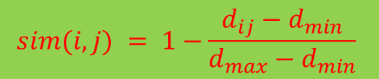
Using Similarity Matrix for Cluster Validation
Order the similarity matrix with respect to cluster labels and inspect visually.
$$sim(i,j) = 1−\frac{d_{ij}−d_{min}}{d_{max}−d_{min}}$$

Slide 9
Using Similarity Matrix for Cluster Validation
Clusters in random data are not so crisp
DBSCAN

Slide 10
Using Similarity Matrix for Cluster Validation
Clusters in random data are not so crisp
K-means

Slide 11
Using Similarity Matrix for Cluster Validation
DBSCAN

Slide 12
Internal Measures: SSE
Internal Index: Used to measure the goodness of a clustering structure without reference to external information
Example: SSE
Can also be used to estimate the number of clusters

Slide 13
Estimating the “right” number of clusters
Typical approach: find a “knee” in an internal measure curve.
Question: why not the k that minimizes the SSE?
Forward reference: minimize a measure, but with a “simple” clustering
Desirable property: the clustering algorithm does not require the number of clusters to be specified (e.g., DBSCAN)

Slide 14
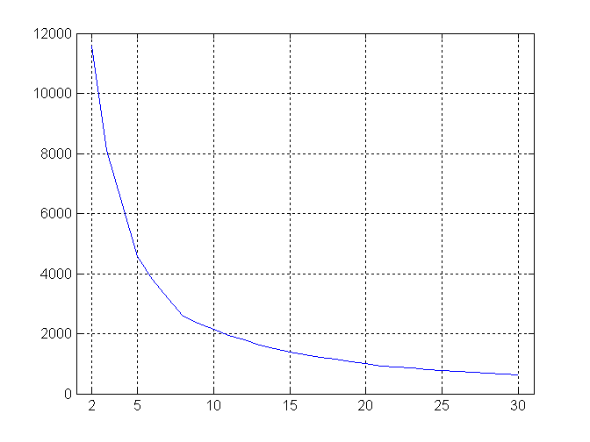
Internal Measures: SSE
SSE curve for a more complicated data set
SSE of clusters found using K-means

Slide 15
Internal Measures: Cohesion and Separation
Cluster Cohesion: Measures how closely related are objects in a cluster
Cluster Separation: Measure how distinct or well-separated a cluster is from other clusters
Example: Squared Error
Cohesion is measured by the within cluster sum of squares (SSE)
Separation is measured by the between cluster sum of squares
Where m_{i} is the size of cluster i and c is the centroid of whole dataset

Slide 16
External Measures for Clustering Validity
Assume that the data is labeled with some class labels
E.g., documents are classified into topics, people classified according to their income, senators classified as republican or democrat.
In this case we want the clusters to be homogeneous with respect to classes
Each cluster should contain elements of mostly one class
Also each class should ideally be assigned to a single cluster
This does not always make sense
Clustering is not the same as classification
But this is what people use most of the time

Slide 17
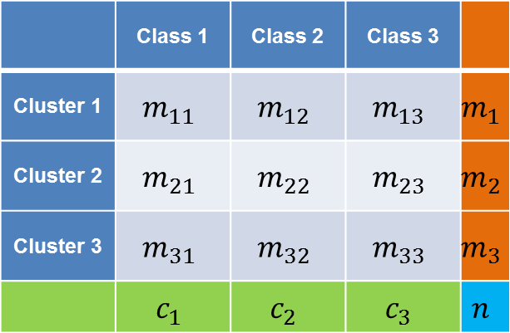
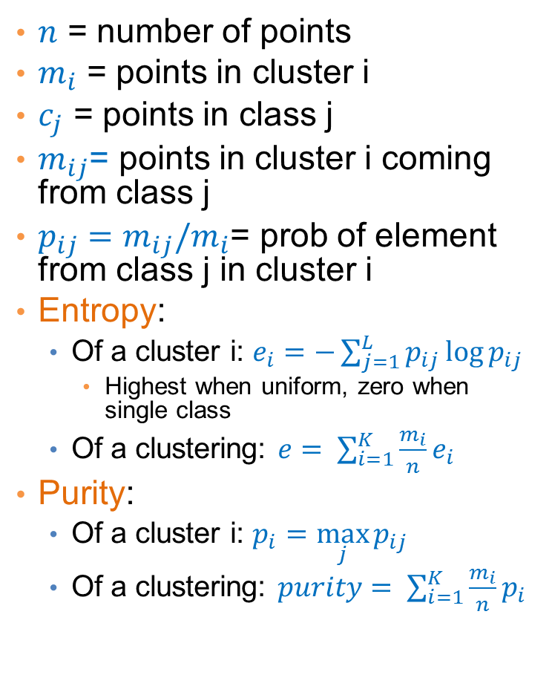
Measures
$n$ = number of points
$m_{i}$ = points in cluster i
$c_{j}$ = points in class j
$m_{ij}$= points in cluster i coming from class j
$p_{ij}=m_{ij}/m_{i}$= prob of element from class j in cluster i
Entropy:
Of a cluster i: $e_{i}=−\sum_{j=1}^{L}{p_{ij}\log{p_{ij}}}$
Highest when uniform, zero when single class
Of a clustering: $e= \sum_{i=1}^{K}{\frac{m_{i}}{n}e_{i}}$
Purity:
Of a cluster i: $p_{i}=\max_{j}{p_{ij}}$
Of a clustering: $purity= \sum_{i=1}^{K}{\frac{m_{i}}{n}p_{i}}$
 | Class 1 | Class 2 | Class 3
Cluster 1 | $$m_{11}$$ | $$m_{12}$$ | $$m_{13}$$ | $$m_{1}$$
Cluster 2 | $$m_{21}$$ | $$m_{22}$$ | $$m_{23}$$ | $$m_{2}$$
Cluster 3 | $$m_{31}$$ | $$m_{32}$$ | $$m_{33}$$ | $$m_{3}$$
 | $$c_{1}$$ | $$c_{2}$$ | $$c_{3}$$ | $$n$$

Slide 18
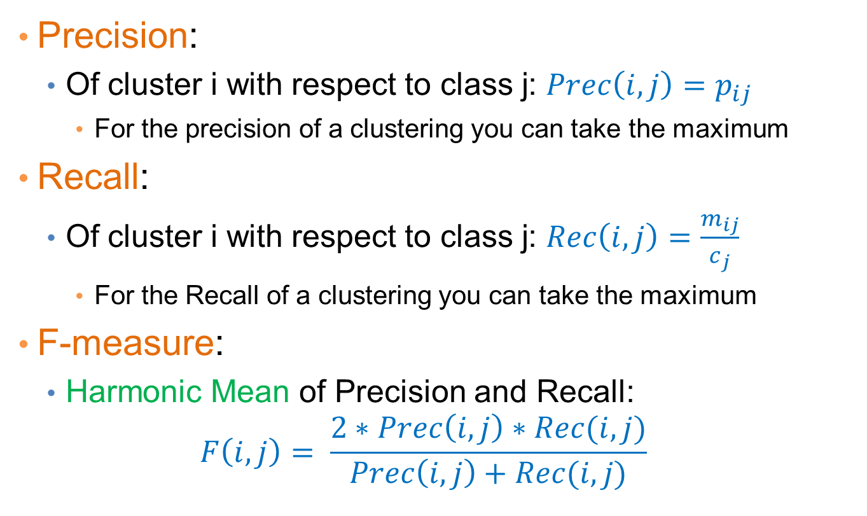
Measures
Precision:
Of cluster i with respect to class j: $Prec\left(i,j\right)=p_{ij}$
For the precision of a clustering you can take the maximum
Recall:
Of cluster i with respect to class j: $Rec\left(i,j\right)=\frac{m_{ij}}{c_{j}}$
For the Recall of a clustering you can take the maximum
F-measure:
Harmonic Mean of Precision and Recall:
$$F\left(i,j\right)= \frac{2∗Prec\left(i,j\right)∗Rec(i,j)}{Prec\left(i,j\right)+Rec(i,j)}$$

Slide 19
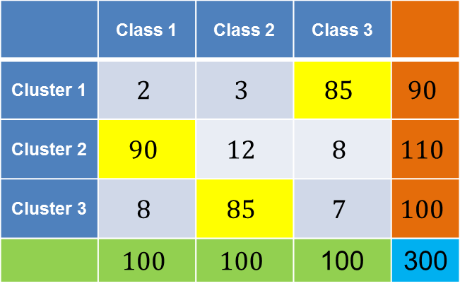
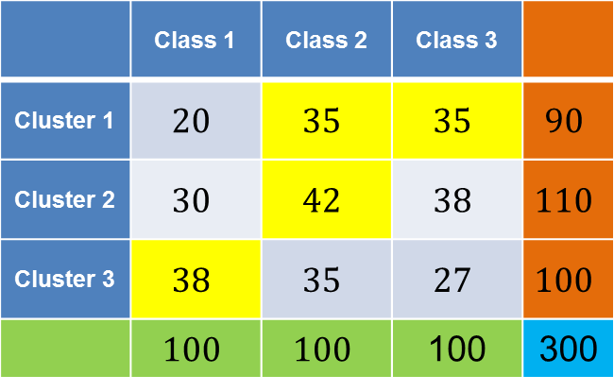
Good and bad clustering
 | Class 1 | Class 2 | Class 3
Cluster 1 | $$2$$ | $$3$$ | $$85$$ | $$90$$
Cluster 2 | $$90$$ | $$12$$ | $$8$$ | $$110$$
Cluster 3 | $$8$$ | $$85$$ | $$7$$ | $$100$$
 | $$100$$ | $$100$$ | 100 | 300
 | Class 1 | Class 2 | Class 3
Cluster 1 | $$20$$ | $$35$$ | $$35$$ | $$90$$
Cluster 2 | $$30$$ | $$42$$ | $$38$$ | $$110$$
Cluster 3 | $$38$$ | $$35$$ | $$27$$ | $$100$$
 | $$100$$ | $$100$$ | 100 | 300
Purity: (0.94, 0.81, 0.85) – overall 0.86
Precision: (0.94, 0.81, 0.85)
Recall: (0.85, 0.9, 0.85)
Purity: (0.38, 0.38, 0.38) – overall 0.38
Precision: (0.38, 0.38, 0.38)
Recall: (0.35, 0.42, 0.38)

Slide 20
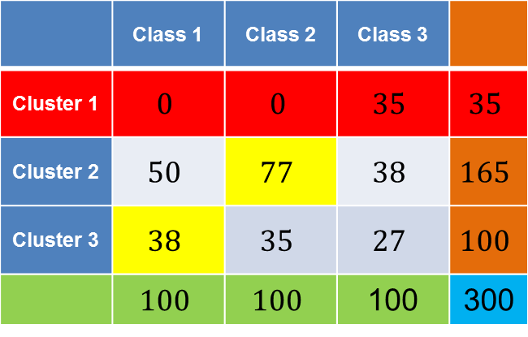
Another bad clustering
 | Class 1 | Class 2 | Class 3
Cluster 1 | $$0$$ | $$0$$ | $$35$$ | $$35$$
Cluster 2 | $$50$$ | $$77$$ | $$38$$ | $$165$$
Cluster 3 | $$38$$ | $$35$$ | $$27$$ | $$100$$
 | $$100$$ | $$100$$ | 100 | 300
Cluster 1:
Purity: 1
Precision: 1
Recall: 0.35

